Slide 1
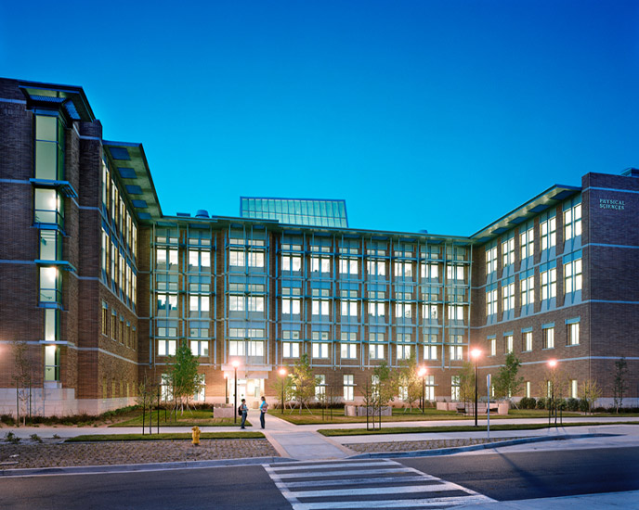
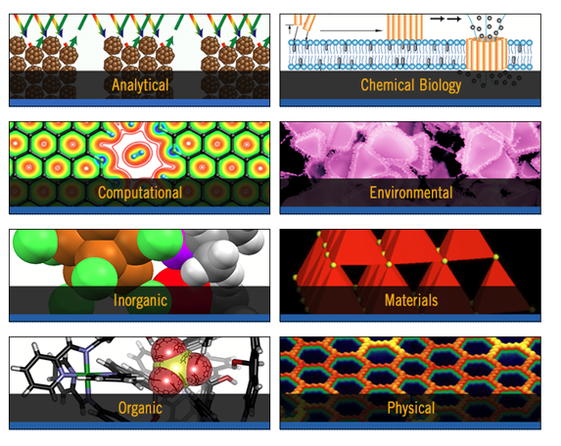
B.S. & B.A. in Chemistry (ACS accreditation)
Options in Environmental Chemistry and Chemical Physics
M.S.
Ph.D.
Chemical
Sciences

Slide 2
Chemistry Program Highlights
36 faculty + 5 CFMs
280 Undergraduate students
160 PhD graduate students
70 Postdoctoral scholars
~$10 Million/year research funding
Faculty with many national and international awards and outstanding research
Vibrant graduate student and undergraduate student research
www.chem.ucr.edu

Slide 3
Chemistry program is highly ranked
# 59 in US News and World Report
(2) #42 on The 50 Best Chemistry Programs in the World Today: http://www.thebestschools.org/features/best-chemistry-programs-in-world-today/
(3) #41 worldwide (25 in US) in the Academic Rankings of World Universities for 2015: http://www.shanghairanking.com/SubjectChemistry2015.html
(4) #36 in US in Nature Index: http://www.natureindex.com/institution-outputs/generate/Chemistry/regions-North%20America/academic/weighted_score

Slide 4
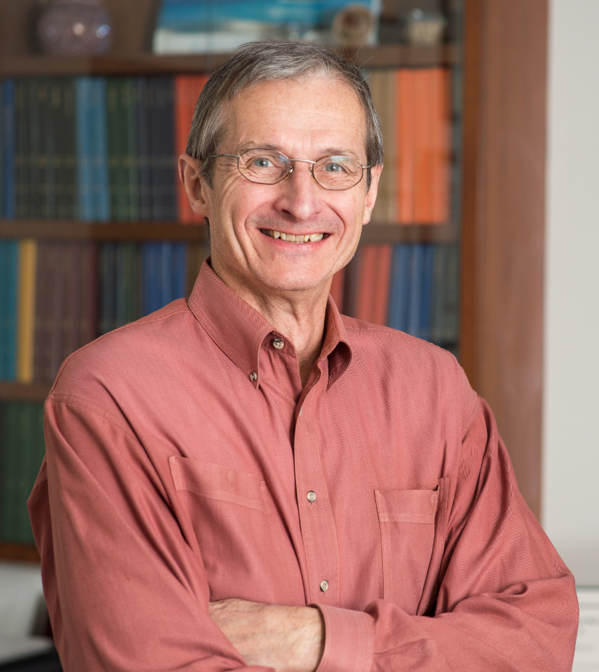
Nobel Prize Winner Joins UC Riverside Chemistry Faculty
UCR alumnus and renowned scholar Richard Schrock will share pioneering science with faculty and students

Slide 5
GPP-C 2018-2019 Schedule
Example
Fall 2018
(September 24 - December 7)
Chem 230 (3) - Nanoscience and Nanotechnology (Lecture)
Winter 2019
(January 7 - March 15)
Chem 114 (4) - Advanced Physical Chemistry Lab (Lecture and Lab)
Spring 2019
(April 1 - June 7)
Chem 166 (4 credits) -- Advanced Structural and Synthetic Methods (Lecture and Lab)
Chem 125W (5) - Intrumental Methods (Lecture and Lab)
Chem 199 (3 credit) - Senior Research
Chem 199 (3 credits) -- Senior Research
Chem 191 (1 creidt) -- Seminars in Chemistry Careers
Chem 199 (3 credits) -- Senior Research
Chem 190 (2) -- Special Studies (Research in lab)
Chem150B (4) - Inorganic Chemistry (systematic introduction to synthesis, reactions, structure, and bonding of important classes of inorganic compounds
Chem 143 (3) -- Chemical Biology (Lecture)
Chem 190 (1) -- Special Studies (Research in lab)

